Slide 1

Computer Security

Slide 2
Syllabus
Introduction
Security threat and Security attack
Malicious Software
Security Services
Security Mechanisms
Cryptography
Digital Signature
Firewall, User Identification and Authentication
Intrusion Detection System
Security Awareness

Slide 3
Introduction
Computer Security
It is all the means and mechanisms used for protecting computer hardware software and data from possible damage and security attacks
It includes security of both computer and internet.
It focuses on
Security attacks: Breach of security
Security mechanisms: algorithm, protocols or devices that are designed to detect, prevent or recover from a security attack
Security services: provided by system for specific kind of protection to the system resources.

Slide 4
Security Threat
Security threat is a potential violation of security or condition which can cause damage to the system or data.
It is a possible danger that might exploit vulnerability
Actions that can cause security attacks.
Eg. Malicious program, natural disaster or thief

Slide 5
Security Attack
It is situation lead by intentional/deliberate action to cause damage to system or data.
Attacks on computer hardware could be burglary of vandalism of hardware
Attacks on computer software and data may be due to malicious software or due to hacking.
Attacks on users could be identity theft and user’s privacy.

Slide 6
Types of Security Attack on the basis of nature
Active attack
Active attack tries to alter the system resources or affect its operations.
Data Alteration
Active attack may be a masquerade(an entity pretends to be someone else)
Denial of service
Replay( Capture events and replay them)

Slide 7
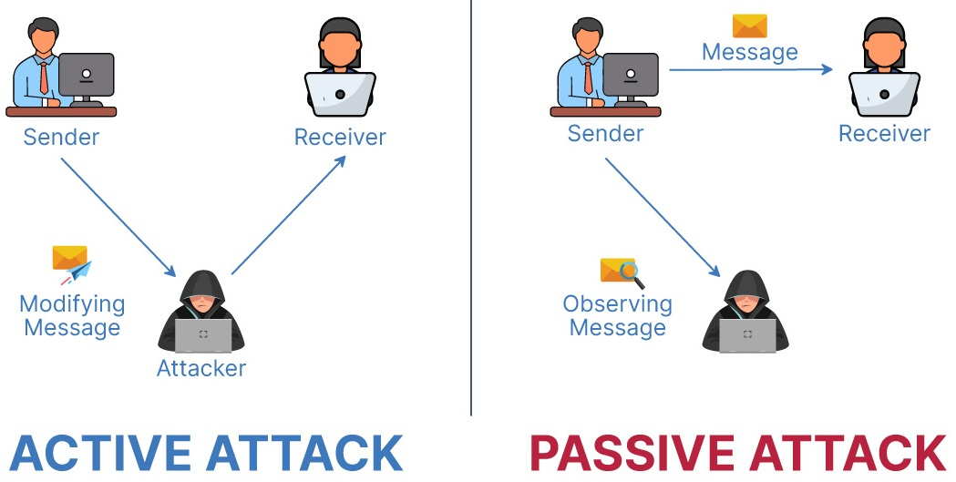
Passive Attack
Interception
Release of message contents
Traffic analysis
Hard to detect but comparatively easy to prevent

Slide 8
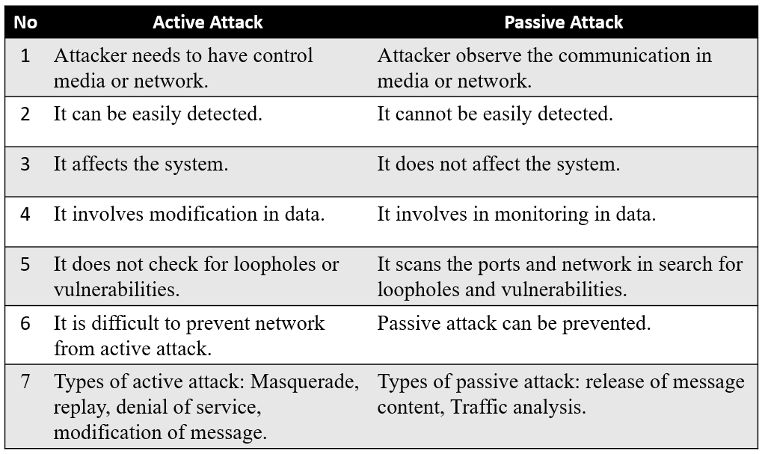

Slide 9
Malicious Software
Software/program that are intentionally created to effect normal functioning of system and data.
Types of malicious software
Virus
Worm
Trojan Horse
Ransomware
Spyware
Adware
Keyloggers

Slide 10
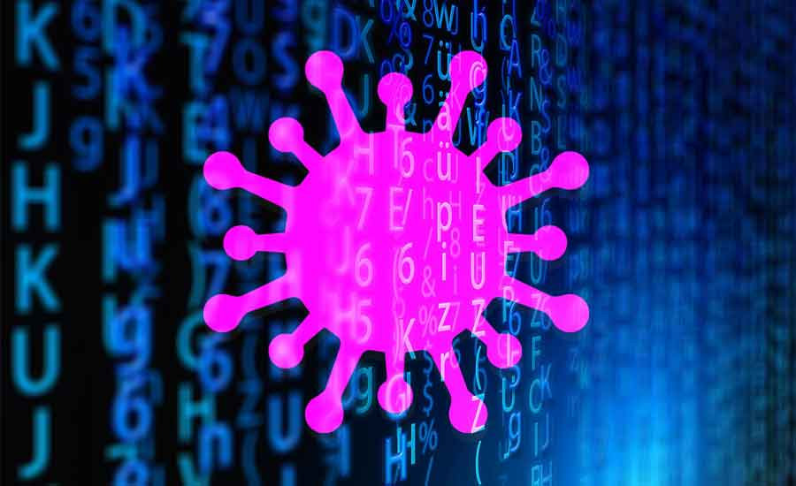
Virus
Virus is computer program created to damage the software application and tamper the data or files on the computer.
Properties of virus
It can attach itself to other (host)healthy programs
It can replicate itself and thus can spread across a network
Virus are most easily spread by attachments in email messages and also spread through download o the Internet.
Once targeted application get infected, it changes the values of application and insert its own new code leading to malfunction of application
And so does manipulate the data files and delete in some cases too
Eg. Melissa Virus and I Love you Virus

Slide 11
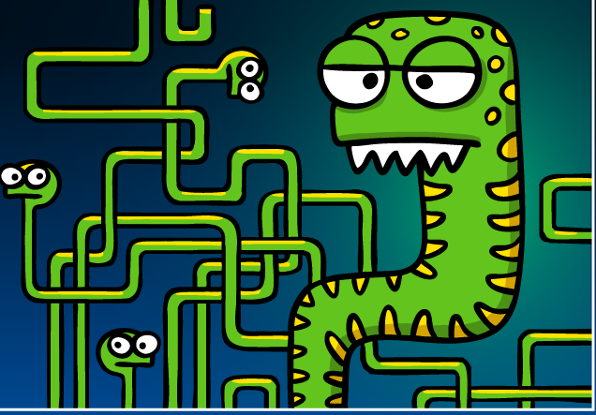
Worm
Worm is self replicating program that is spread in network through loopholes. It does no effect the data or any application but it makes duplicates to the extent that the storage of computer becomes full which makes computer slow in operation or unfunctional.
Ex. Code Red, Nimda

Slide 12
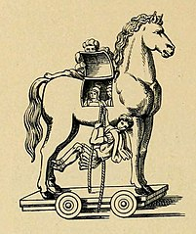
Trojan Horse
It is malicious program that disguise itself as an legitimate application and gets activated only when it is executed.
It cannot replicate itself like virus and worms.

Slide 13
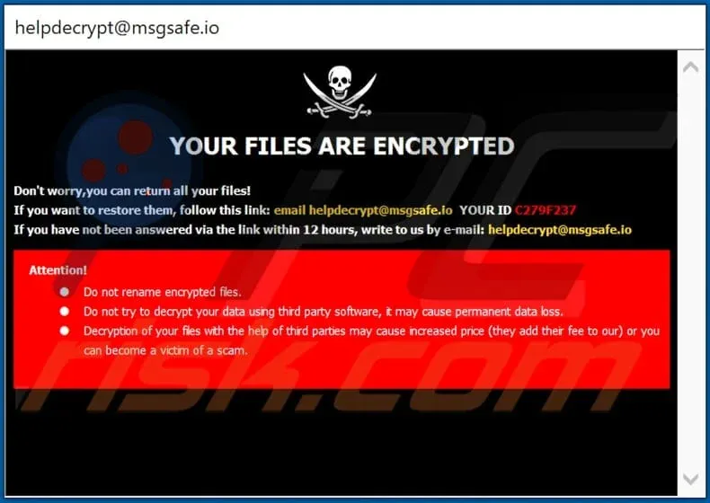
Ransomware

Slide 14
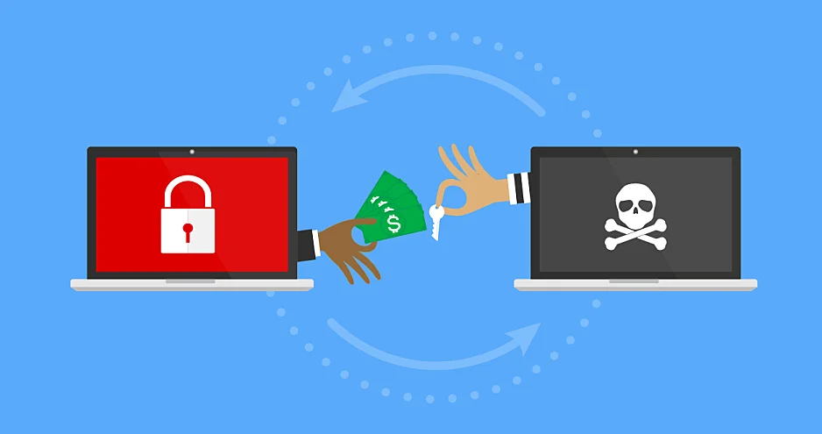
Ransomware
Ransomware is a type of malware that locks and encrypts a victim’s data, files, devices or systems, rendering them inaccessible and unusable until the attacker receives a ransom payment.
It changes the extension of all the files of the victim’s computer and adds new file with the information of being data hijacked.
There is still not guarantee that our data will be recovered even if we pay those ransom in mention account

Slide 15
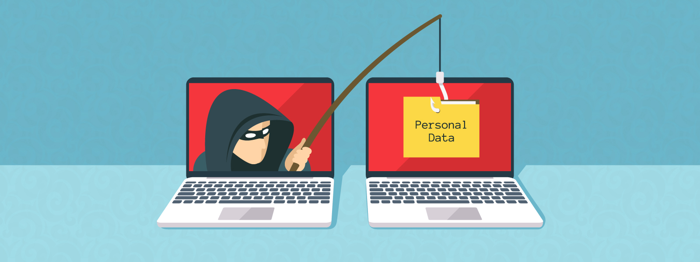
Spyware
Spyware is malicious software that enters the users computer and gather information from user and send it to third party without user’s consent.

Slide 16

Adware

Slide 17
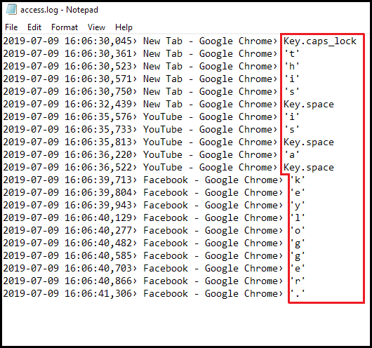
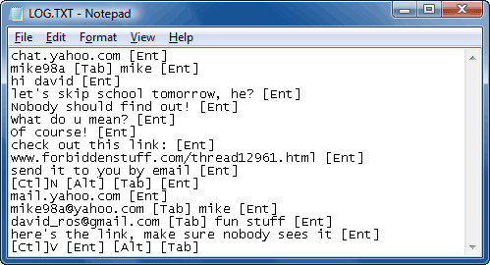
Keylogger
Keylogger is application that records or track the keystrokes/Keypress activities. While there are legitimate use of this application but it can very dangerous on hands of bad intentioned user.

Slide 18
Security Services
Security services provide specific kind of protection to system resources.
Security services ensures
Confidentiality
Integrity
Authentication
Non Repudiation
Access Control
Availability of resources

Slide 19
Confidentiality
This aspect ensures availability of information to only authorized users. In other words, it is the protection of data from unauthorized disclosure.
It ensures privacy of data stored on a server or while transmission on network from being intercepted or stolen by unauthorized users.
Data encryption is used for ensuring confidentiality.
Data encryption stores or transmits data in a form that unauthorized users cannot understand.

Slide 20
Integrity
It assures that the received data is exactly as sent by the sender.
It ensures data has not been tampered before reaching the intended recipient.
It also ensures the accuracy of data during storing and retrieving information

Slide 21
Authentication
Authentication is the process of ensuring and confirming the identity of the user before revealing any information to the user.
It also assures that the source of the received data is as claimed.
Authentication is facilitated by the use of username and and password, smart cards, biometric methods like retina scanning and fingerprints.

Slide 22
Non Repudiation
It prevents either sender or receiver from denying a transmitted message.
For a message that is transmitted, proofs are available that the message was sent by the alleged sender and the message was received by the intended recipient.
For example, if a sender places an order for certain product to be purchased in a particular quantity, the receiver knows that it came from a specified sender. Non repudiation deals with signatures.

Slide 23
Availability
It assures that the data and resources requested by authorized users are available to then when requested.

Slide 24
Security Mechanisms
Security mechanisms are set of tools that deals with prevention, detection and recovery from a security attack.
Prevention: involves mechanisms to prevent the computer from being damaged
Detection: requires mechanisms that allow detection of when, how and by whom and attacked occurred.
Recovery: involves mechanism to stop the attack, assess the damage done and then repair the damage
Security mechanisms technologies:
Cryptography
Digital signature
Firewall
User Identification and authentication
Other security measures

Slide 25
Cryptography
Cryptography Terminology:
Encryption: Process of transforming plain text into cipher text using encryption algorithm and key is call encryption.
Decryption: Process of transforming cipher text using decryption algorithm and key is called decryption.
Cipher and Code - Cipher is a bit-by-bit or character-by-character transformation without regard to the meaning of the message. Code replaces one word with another word or symbol. Codes are not used any more.
Cipher text - It is the coded message or the encrypted data.
Key is a secret parameter (string of bits) for a specific message exchange context. The encrypted data cannot be accessed without the appropriate key. The size of key is also important. The larger the key, the harder it is to crack a block of encrypted data

Slide 26
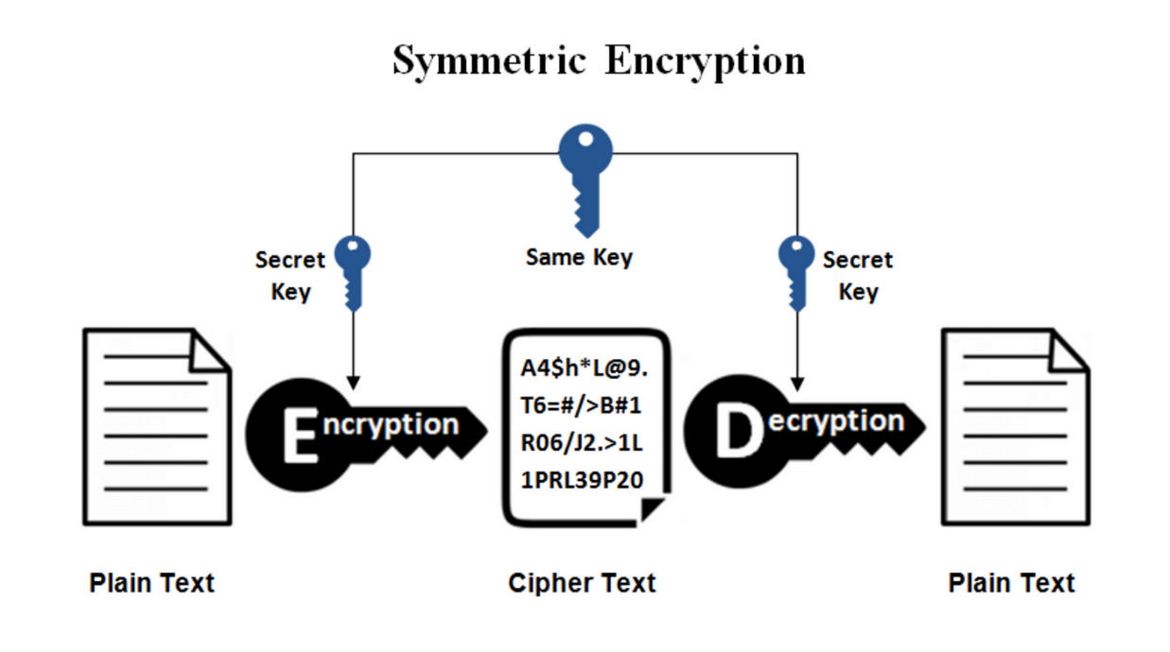
Cryptography Schemes

Slide 27
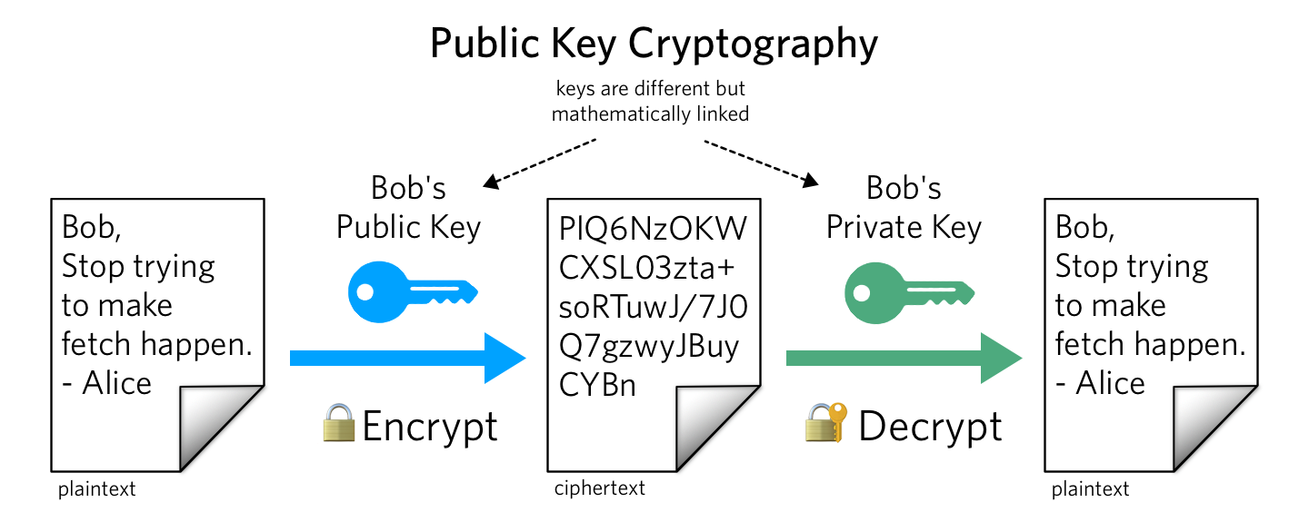
Cryptography Schemes

Slide 28
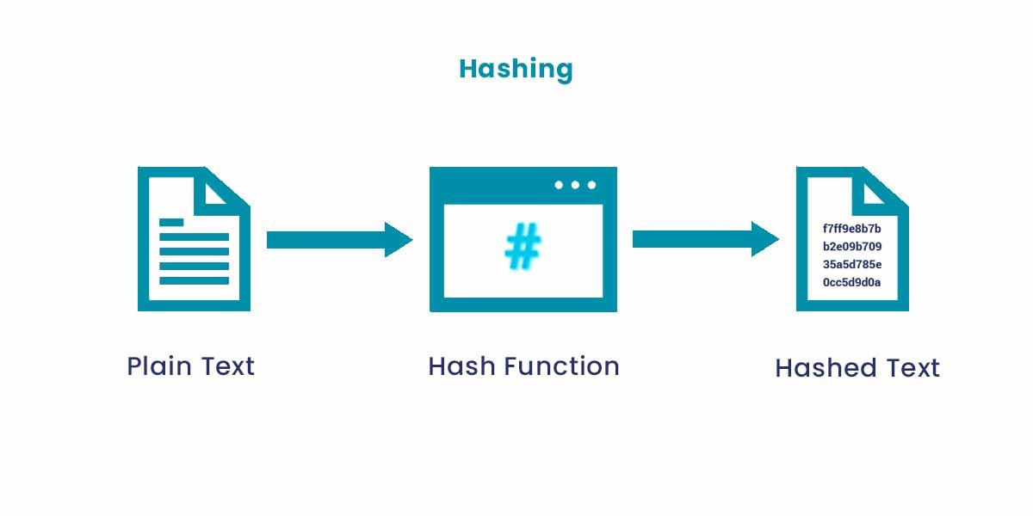
Cryptography Schemes
Hash function :
Hash functions are one-way encryption algorithms and doesn’t use key. This scheme computes a fixed-length hash value based upon the plaintext. Once a hash function is used, it is difficult to recover the contents or length of the plaintext. Uses a mathematical transformation to irreversibly encrypt information.

Slide 29
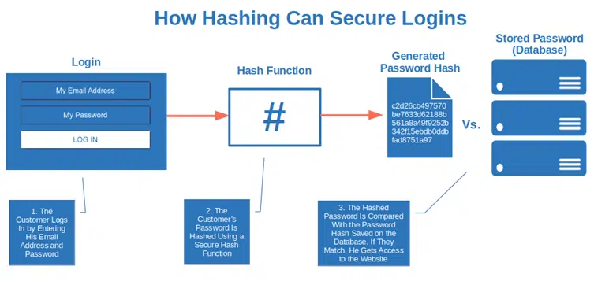
Cryptography Schemes

Slide 30
Cryptography Schemes
Cryptography is used in applications like, security of ATM cards, computer passwords, and electronic commerce. Cryptography is used to protect data from theft or alteration, and also for user authentication

Slide 31
Digital Signature
A signature on a legal, financial or any other document authenticates the document. A photocopy of that document does not count.
A digital signature is used to sign a computerized document must hold conditions below
The receiver is able to verify the sender (as claimed),
The sender cannot later repudiate the contents of the message
Data Integrity: Data was not altered during transmission
Digital signature is mathematical code for demonstrating the authenticity of digital messages or documents that lets you sign a document electronically and validates the signer.
Digital signatures are easy for a user to produce, but difficult for anyone else to forge. Digital signatures can be permanently tied to the content of the message being signed and then cannot be moved from one document to another, as such an attempt will be detectable.
Digital signature scheme is a type of asymmetric cryptography.

Slide 32
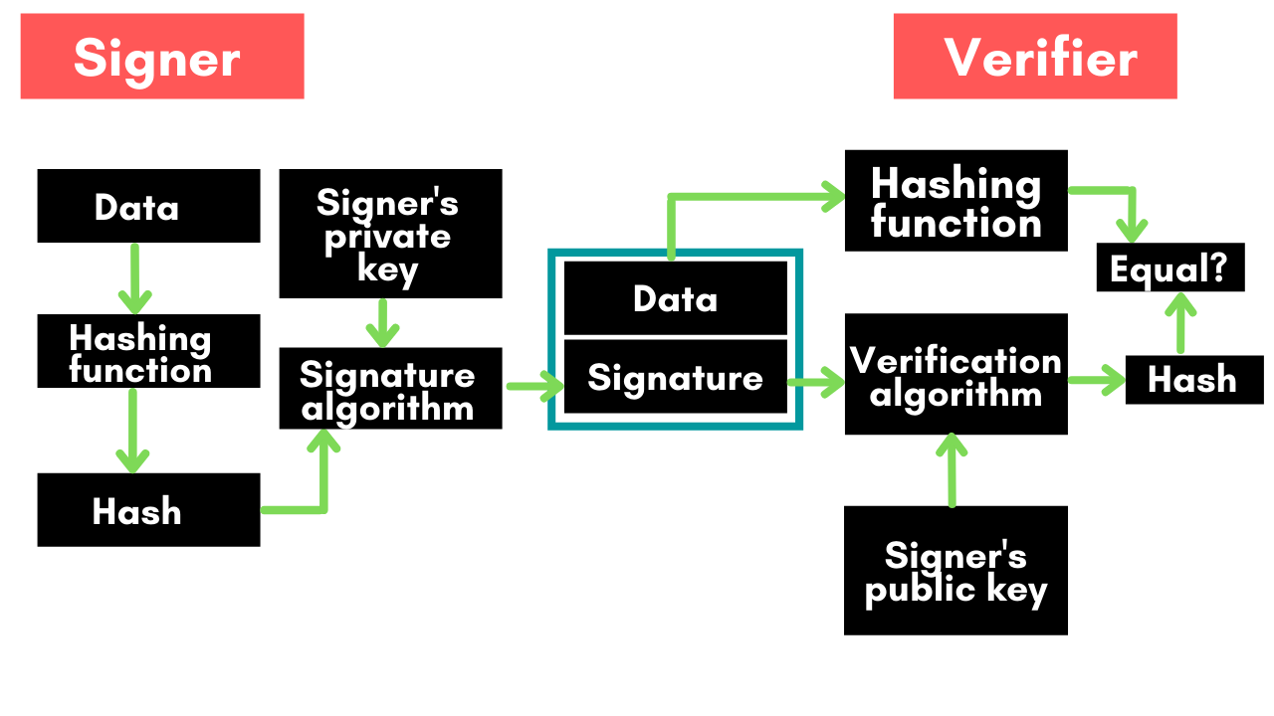
Digital Signature

Slide 33
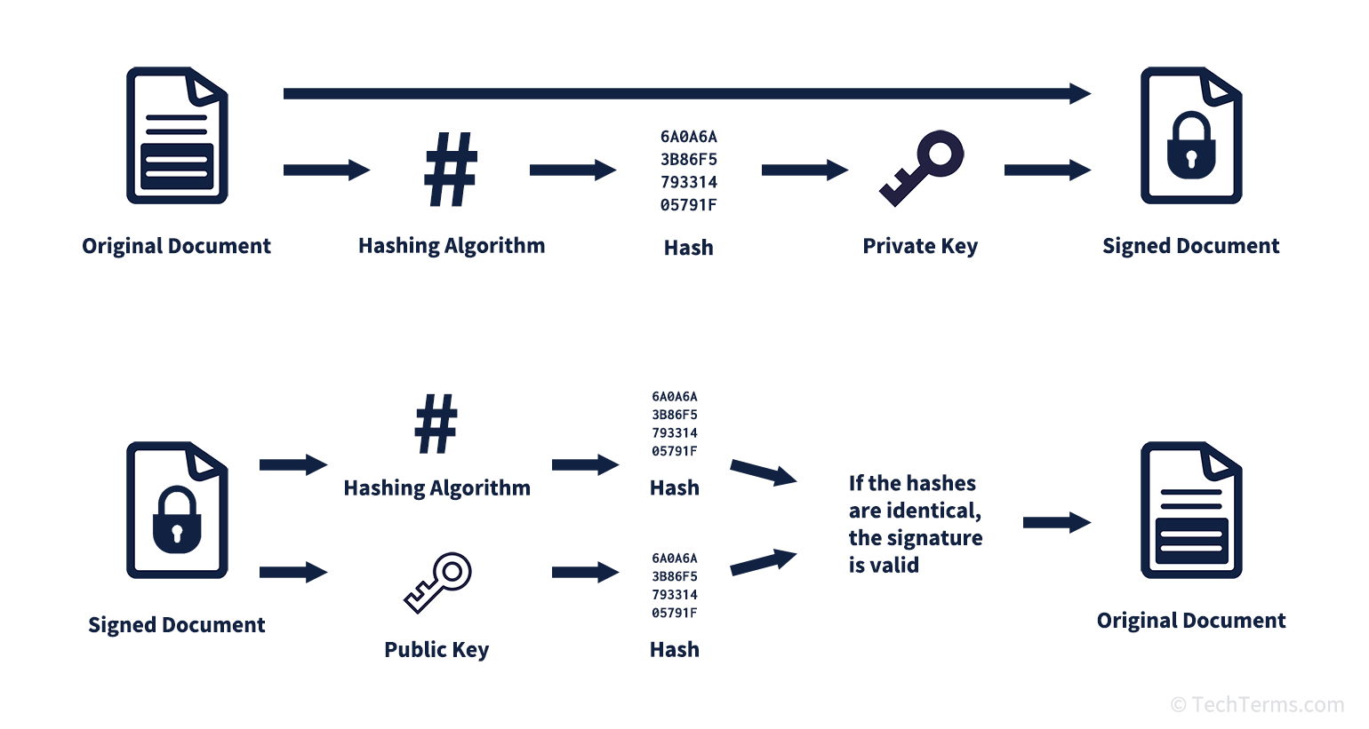
Digital Signature

Slide 34
Firewall
A firewall is a security mechanism to protect a local network from the threats it may face while interacting with other networks (Internet).
All communication takes place through the firewall, which examines all incoming data before allowing it to enter the local network.
A firewall can be a hardware component, a software component, or a combination of both.

Slide 35
Working of Firewall
The working of firewall is based on a filtering mechanism. The filtering mechanism keeps track of source address of data, destination address of data and contents of data.
It makes sure that the downloading of information from the Internet to a local network happens based only on a request by an authorized user.
Functions of Firewall
Firewalls provide security by examining the incoming data packets and allowing them to enter the local network only if the conditions are met.
Firewalls can be used for hiding the structure and contents of a local network from external users. Network Address Translation (NAT) conceals the internal network addresses and replaces all the IP addresses of the local network with one or more public IP addresses

Slide 36
Types of Firewall
Packet filter firewall
Circuit filter firewall
Proxy server of Application level gateway

Slide 37
Packet filter firewall
Applies set of rules on each incoming packet and forwards the packet if rules are obeyed otherwise discard.
Rules are based on
Source IP address
Destination IP address
Protocols and Ports
Also maintains a filtering table
Simple but less secure

Slide 38
Application Level Gateway
Is also called Proxy Sever
Proxy server is present between the host and clients.
Client uses its IP address to request the services from host though proxy server
Proxy server uses its own IP details while requesting host which makes the actual clients identity anonymous.
More secure than Packet Filtering
Contacts user by TCP/IP protocols(TELNET, FTP, SMTP, HTTP, etc)

Slide 39
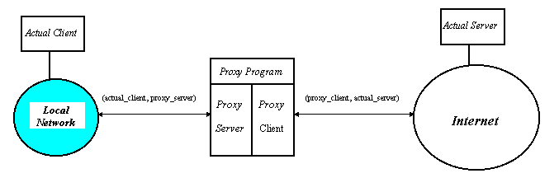
Application Level Gateway

Slide 40
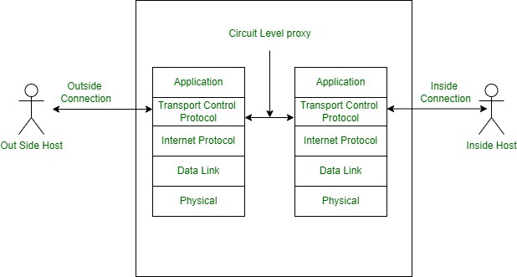
Circuit Filter Farewell
It uses two TCP connections
Internal host and Gateway
External host and Gateway
Fastest

Slide 41
User Identification and Authentication
Identification is the process whereby a system recognizes a valid user’s identity.
Authentication is the process of verifying the claimed identity of a user .
For example, a system uses user password for identification. The user enters his password for identification. Authentication is the system which verifies that the password is correct, and thus the user is a valid user.
Before granting access to a system, the user’s identity needs to be authenticated. If users are not properly authenticated then the system is potentially vulnerable to access by unauthorized users. If strong identification and authentication mechanisms are used, then the risk that unauthorized users will gain access to a system is significantly decreased.

Slide 42
User Identification and Authentication
Authentication mechanisms are:
User name and password
Smart Card
Biometrics—Fingerprints, Iris/retina scan
Once the user is authenticated, the access controls for the user are also defined. Access controls is what the user can access once he is authenticated.

Slide 43
Intrusion Detection System
They complement firewalls to detect if internal assets are being hacked or exploited.
Inside Intruder & Outside Intruder
A Network-based Intrusion Detection monitors real time network traffic for malicious activity and sends alarms for network traffic that meets certain attack patterns or signatures.
A Host-based Intrusion Detection monitors computer or server files for anomalies and sends alarms for network traffic that meets a predetermined attack signature.
Signature based IDS and Anomaly based IDS

Slide 44
Security Awareness
The aim of the security awareness is to enhance the security of the organization’s resources by improving the awareness of the need to secure the system resources.
Staff members play a critical role in protecting the integrity, confidentiality, and availability of IT systems and networks. It is necessary for an organization to train their staff for security awareness and accepted computer practices.
Security of resources can be ensured when the people using it are aware of the need to secure their resources. Security awareness of staff includes the knowledge of practices that must be adhered to, for ensuring the security and the possible consequences of not using those security practices.

Slide 45
Security Policy
A security policy is a formal statement that embodies the organization’s overall security expectations, goals, and objectives with regard to the organization’s technology, system and information.
The security policy states what is, and what is not allowed.
A security policy must be comprehensive, up-to-date, complete, delivered effectively, and available to all staff.
A security policy must also be enforceable. To accomplish this, the security policy can mention that strict action will be taken against employees who violate it, like disclosing a password.

Slide 46
Formulating Security Policy
The steps followed while formulating the security policy are:
Analyzing Current Security Policies
Identifying IT Assets that Need to be Secure
Identifying Security Threats and Likely Security Attacks
Defining the Proactive and Reactive Security Strategies
A proactive strategy is a pre-attack strategy. It involves identifying possible damage from each type of attack, determining the vulnerabilities that each type of attack can exploit, minimizing those vulnerabilities and making a contingency plan.
A reactive strategy is implemented on the failure of the proactive strategy. It defines the steps to be taken after the attack. It aims at identifying the cause of attack, vulnerabilities used to attack the system, damage caused by the attack, and repairing of the damage caused by the attack.

